Slide 1
Buffer-Overflow Detection
Alen Shaju

Slide 2
Initial Problem Statement
The problem is to figure out a method to identify code with bugs such as buffer overflows in python.

Slide 3
Initial Approach
Initial step is to determine the complexity of the code in compiled languages as they’re more prone to buffer overflows.
  Configured GNU Complexity Measurement tool of C source for this approach.
    tool uses multiple factors such as code length, Switch Statements, Logic Conditions.
    The complexity computation is done by counting lines of non-comment source lines, multiplies by a “nesting factor” for each level nesting and divides by a scaling factor so that the typical results lie roughly in the same range as pmccabe results

Slide 4
Tools used for Initial Approach
Lizard
  Extensible Cyclomatic Complexity Analyzer for many imperative programming languages including C/C++.
  It counts the nloc (lines of code without comments), CCN (cyclomatic complexity number), token count of functions and parameter count of functions.
Other tools: CCCC

Slide 5
Final Problem Statement
The problem is to figure out a method to identify code with buffer overflows in C/C++.

Slide 6
Papers studied
Papers used:
  “A Taxonomy of Buffer Overflows for Evaluating Static and Dynamic Software Testing Tools”
  “Evaluating Static Analysis Tools for Detecting Buffer Overflows in C Code”

Slide 7
Final Approach
The complexity was determined by the different types of values that were passed in to the buffer such constant, variable, linear expression, non-linear expression, function return value and array contents.
  Translate the C/C++ program in to assembly MIPS code.
  Used the online tool compiler explorer-C++.
    It translates C/C++ code into x86-64 gcc 4.4.7 assembly code.
The complexity of the program was determined based on the description the values with constant as the lowest complexity and array contents as the highest complexity.

Slide 8
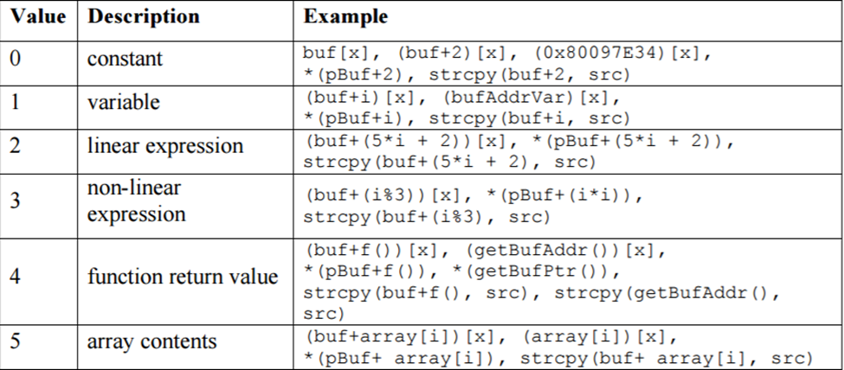
Final Approach (cont..)

Slide 9
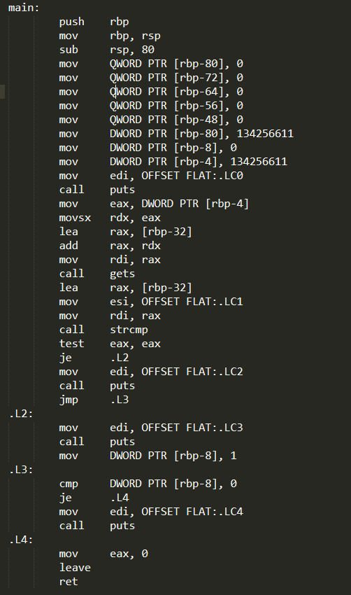
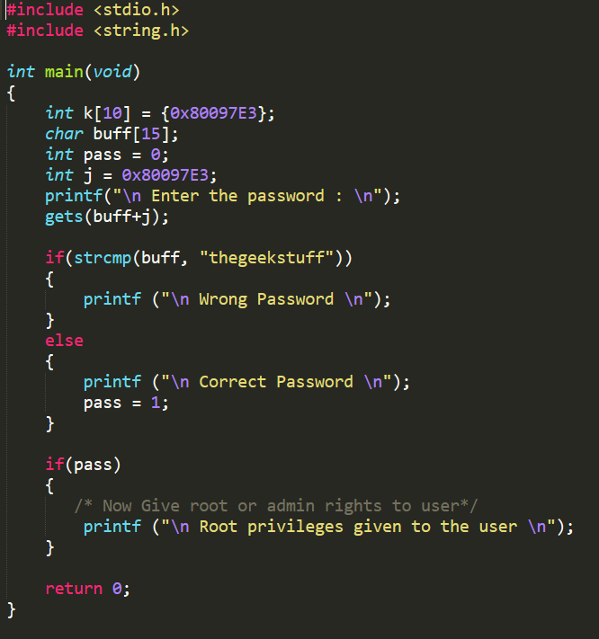
Final Approach (cont..)

Slide 10
Final Approach (cont..)
Higher Complexity
  C++ : “gets(buff+k[10]);”
  ASM: “mov eax, DWORD PTR [rbp-40]”
    offset of ‘40’
Lower Complexity
  C++: “gets(buff+j);”
  ASM: “mov eax, DWORD PTR [rbp-4]”
    lower offset ‘4’
Work is still not completely done, due to time constraints.

Slide 11
Datasets
Github
  Scrape code with commit URL as input
    Not perfect
  Manually pull data from github.

Slide 12
References
Rawat, S., & Mounier, L. (2012). Finding Buffer Overflow Inducing Loops in Binary Executables. 2012 IEEE Sixth International Conference on Software Security and Reliability. doi:10.1109/sere.2012.30
Parsa, S., Asadi-Aghbolaghi, M., & Vahidi-Asl, M. (2011). Statistical Debugging Using a Hierarchical Model of Correlated Predicates. Artificial Intelligence and Computational Intelligence Lecture Notes in Computer Science, 251-256. doi:10.1007/978-3-642-23881-9_32
Kratkiewicz, K. (n.d.). A Taxonomy of Buffer Overflows for Evaluating Static and Dynamic Software Testing Tools. Retrieved from https://www.ll.mit.edu/mission/cybersec/publications/publication-files/full_papers/061107_Kratkiewicz.pdf.
Kratkiewicz, K. J. (march 2005). Evaluating Static Analysis Tools for Detecting Buffer Overflows in C Code. Retrieved from https://www.ll.mit.edu/mission/cybersec/publications/publication-files/full_papers/KratkiewiczThesis.pdf.

